Slide 1



Cadette Amaze Journey
Part 3

Slide 2
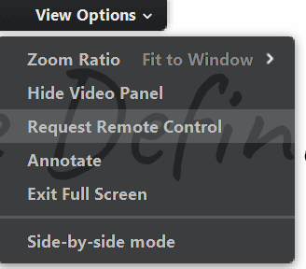
How will this Virtual Troop Meeting Work?
On bottom of your screen, there is a control panel. You should see a microphone, a video camera and a chat bubble.
When asked to speak, click on your microphone so it is green. Then everyone will be able to hear you.
If you have a webcam, clicking on it will let everyone else in the meeting see you too.
The Chat Log looks like a cartoon thought bubble. You can type questions or comments into the chat log and everyone will be able to see what you write!
          At the top of your screen is “View Options.” We will be using the “Annotate” option throughout this journey. Please only use this feature when asked.
          Use the “Escape” button to exit annotate and remember to clear the drawings when finished.
Notes:
And keep in mind…

Slide 3
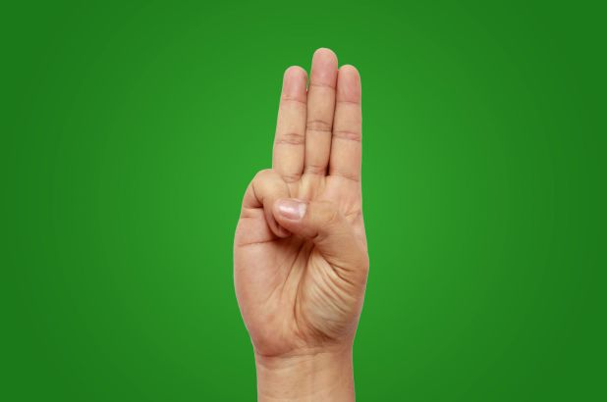
Girl Scout Promise & Law
Girl Scout Promise
On my honor,
I will try, to serve God,
and my country, to help people at all times,
and to live by the Girl Scout Law.
Girl Scout Law
I will do my best,
to be honest and fair,
friendly and helpful,
considerate and caring,
courageous and strong,
responsible for what I say and do,
to respect myself and others,
respect authority,
use resources wisely,
make the world a better place and
be a sister to every Girl Scout.

Slide 4

Cadette Amaze Journey
This journey has three parts or awards.
Award 1. Interact – The ins and outs of people.
Award 2. Peacemaker – A toolkit
Award 3. Diplomat – Your Take Action Project
To finish the journey you will be required to complete a Take Action Project. The details will be discussed in Award 3 and additional materials will be provided in the post workshop email.

Slide 5
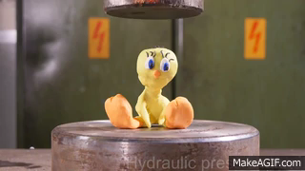
Remember its called
Peer Pressure
Take a stand! Right now, against peer pressure.
Pressure isn’t just what others do to you.
It’s also what you do to others. Build up your courage and make decisions that represent your true self and maybe even inspire others to do the same.
Peer pressure can be negative or positive. It can also be silent.
Notes:
Just a reminder to get back on topic from Part 2.

Slide 6
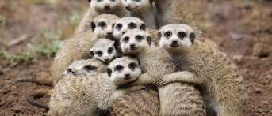
Saying NO to pressure.
Everyone wants to have the feeling of belonging. Knowing that you matter to someone else. It’s a basic human need. But sometimes we want it so badly that we trade-off some of our values. But small trade-offs add up and chip away at our sense of what is right. Habits are formed and characters changed.
Giving into pressure or dishing it out comes from a lack of confidence. If you say “no,” to something will people still like you? The right people will. Your True friends will take you as you are and only push when it is actually good for you with encouragement and not bully tactics.

Slide 7
“Where Do You Stand” Scenarios
Agree
Disagree
Start Here
Notes:
Ask the girls how they would handle these scenarios.
Have girls add their answers to the spectrum.
It’s good to tell a friend she should study harder and try to get better grades.
If you friend really wants you to attend her piano recital because she needs a confidence boost, you should go-even though it sounds like a lot of clanging to you.
It’s OK to attend a party at your best friend’s house even if her parents aren’t there the entire night.
I’d cancel plans with my friend if my crush asked me out at the last minute.
If you’re jealous of someone, it’s OK to be mean to her, as long as you aren’t physically violent.
If a friend is really hurting herself through behavior that you find scary, keep it a secret, no matter what.
You can watch a movie at a friend’s house that your parents would never let you watch at home.
It’s OK to tell your parents that party is “girls-only,” even though there will be boys and you hope to meet up with a special one there.
Sometimes you have to skip the fun to get some homework done.
Sometimes you just have to stop hanging out with some girls because others don’t think they’re cool.
It’s cool to disrespect your parents in front of friends.
You need to try out for a team sport or cheerleading, because everyone does.
It’s important to act like you have more money than you really have.

Slide 9
Surfing through Cyber Relationship
What’s the funniest mass email you ever saw?
Which do you like the most: IMing, texting, social media or e-mailing? Why?
If you could visit only one Web site for the rest of your life, what would it be and why?
Now we are going to break into smaller groups for some discussion.
We’ve talked about first impressions, stereotypes, peer pressure and cliques.
Choose one of these topics and brainstorm how it “looks, feels, and sounds” online.
What are some ways you can promote better friendships online?
Notes:
Did you know that….
68% of girls have had a negative experience on a social networking site, such as having someone gossip about them or being bullied.
b. Almost half (46%) think that social networking creates jealousy among friends.
c. 40% admit to losing respect for a friend because of something she posted on a social network.
REMEMBER that what you say online….stays online FOREVER!

Slide 10
We have a challenge for each of you.
Actually, three challenges.
Following is a list of activities. To achieve the Interact Award you need to complete three of the challenges. You can choose which three. Just remember all that you learn to complete them.
Think before you react or respond!
Notes:
Do you have any questions about the challenges? We can use this time (If there is time left) to brainstorm together.

Slide 11
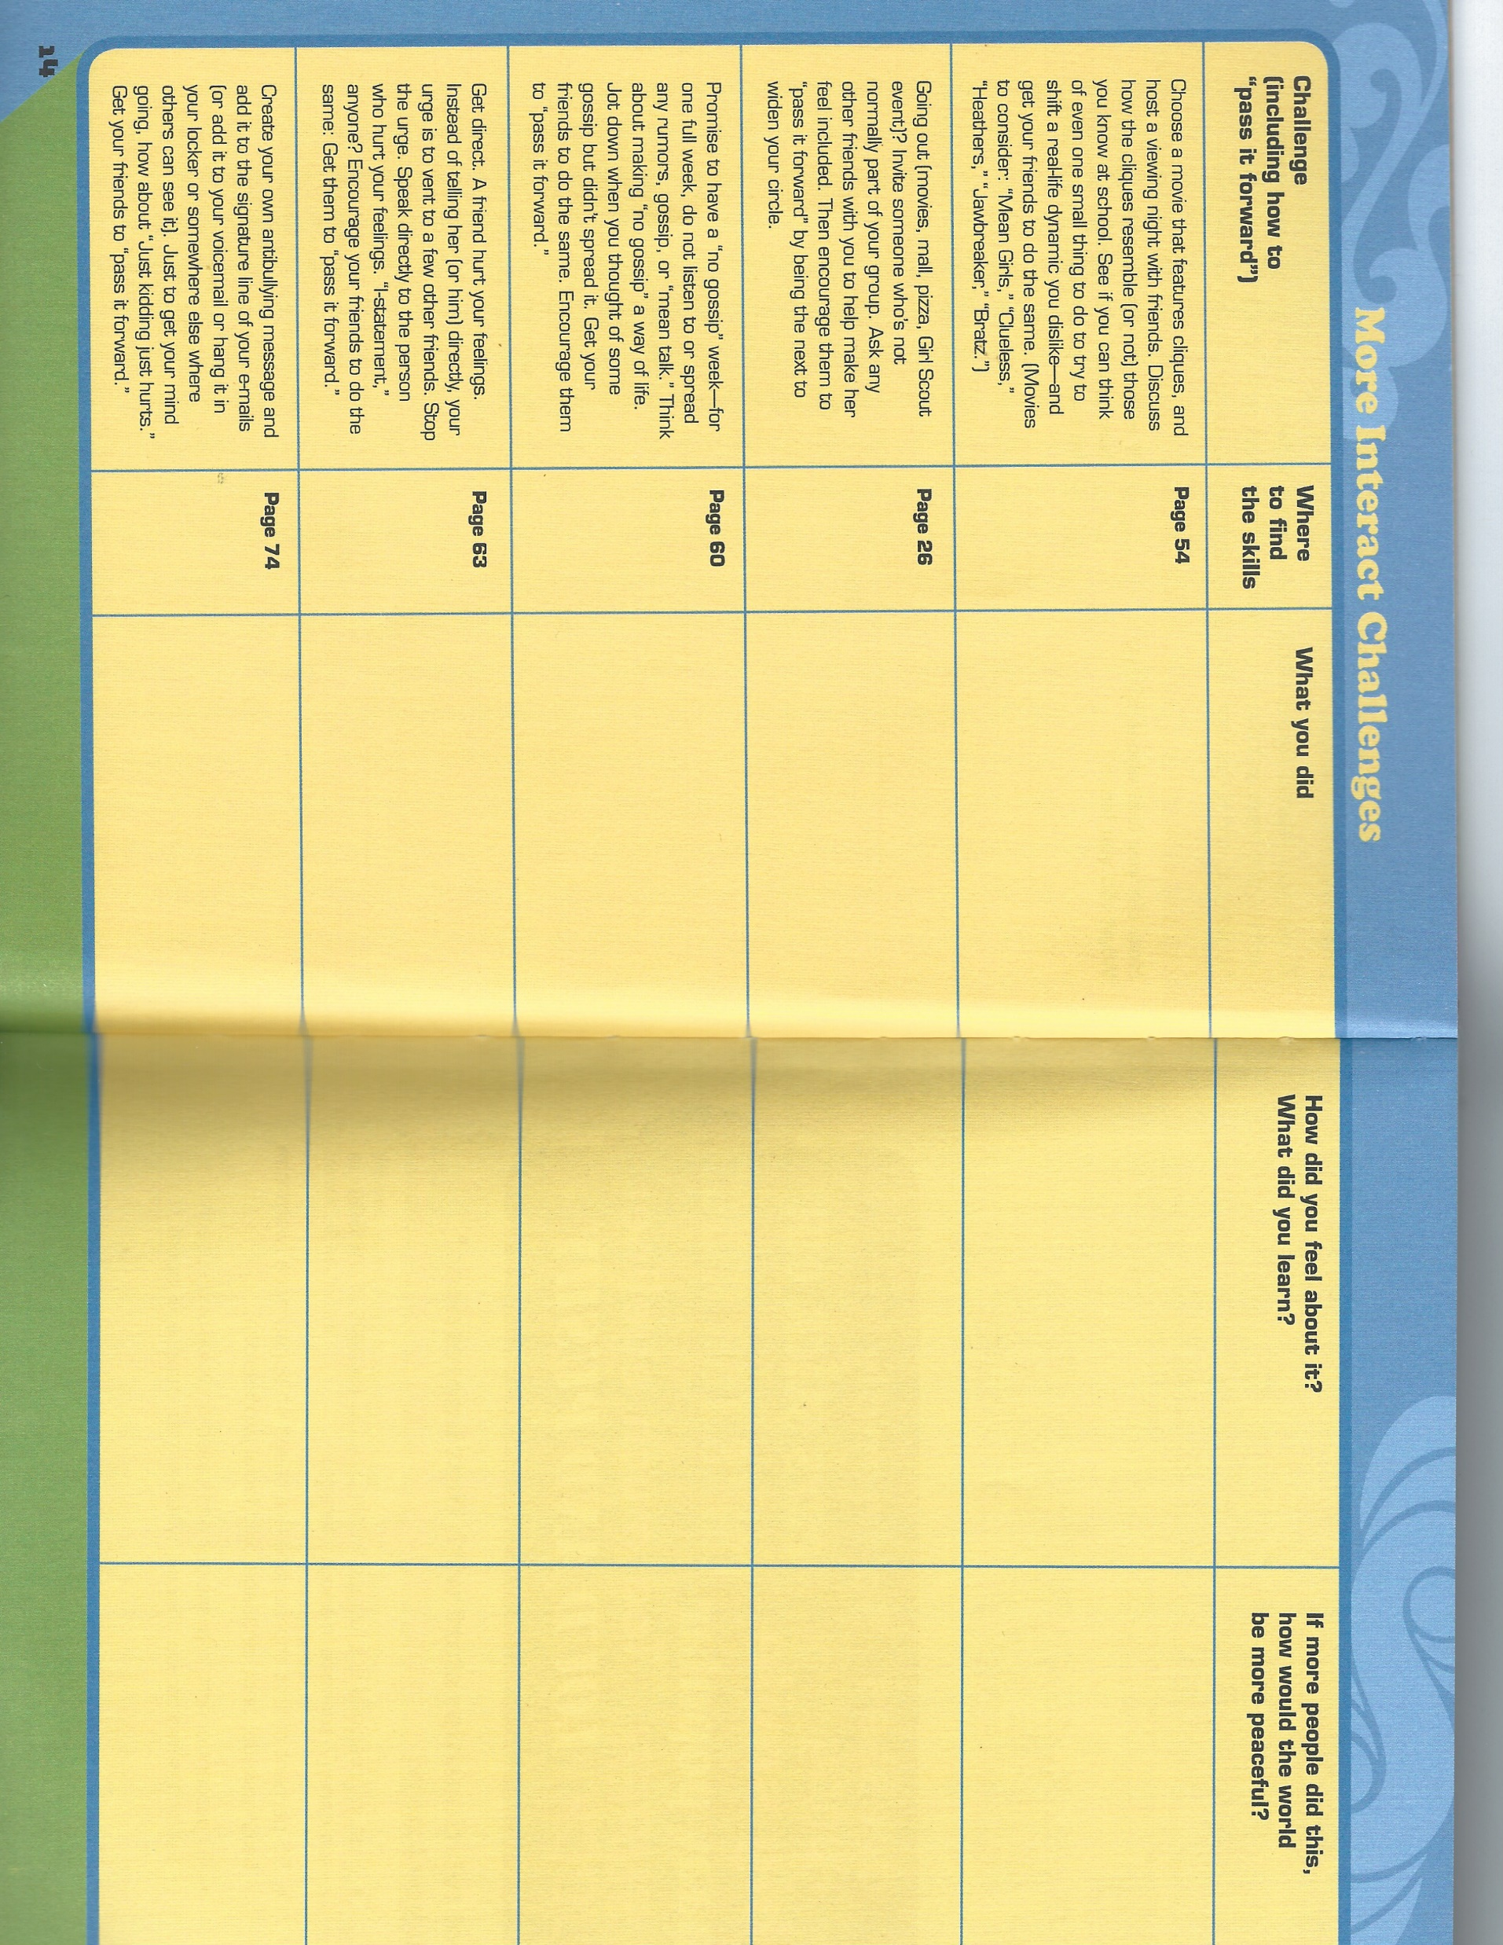
Notes:
Challenges

Slide 12

Time to Act
A Take Action Project (TAP) is a Girl Scout tradition and a way for girls to change the world one issue at a time. Journeys are the gateway to the TAP, providing tools and brainstorming. Now that we have navigated the waters of friendship, it is time for you to push it forward and make your effort at changing your world.
And remember that you do not have to work alone. If you have an idea for a TAP enlist the help of your friends, your family and especially your troop. Projects can be as small as making cards or as large as changing the government’s policy.

Slide 13

Three forms were sent with your pre-workshop email. These forms will help you plan your TAP. Use them as a staring point.
It is always a good idea to share your ideas with others. Its called Brainstorming. Having more than one mind to work on a problem offers different views and more ideas and be shared.
Get your friends or troop together and brainstorm some ideas. Maybe your idea is similar to someone else’s. You could work together.
Maybe a friend doesn’t have any ideas. Invite her to work with you. There is no limit on the number of people working on a TAP.

Slide 14


Seven Steps to earn your Diplomat award.
Identify a relationship issue you want to take action on.
Brainstorm a solution.
Assess your resources.
Create a realistic plan, including a timeline.
Spread the word.
Carry out your Take Action Project
Reflect on your project’s results.
You can use these same steps and planning tools for any TAP – whether in Girl Scouts or anytime in your life.

Slide 15
Ideas
Does your local library offer programming for kids? You could offer a workshop to encourage kids in better navigating their maze of relationships.
Partner with a trusted adult, like a teacher, and together run a friendship advice column for your school newspaper or radio station.
Work with friends to create skits about the difference circles and cliques. Offer suggestions about how to peacefully exit a cliquish situation. Present to younger troops or at school if permitted. Create a video.

Slide 16
Ideas
Is there an issue that the trusted adults just don’t understand? Make a humorous video highlighting the issue. Help them understand. Just remember adult as well as kids will be more vested in your presentation if it is presented with respect.
Does something occur at lunch everyday and the faculty just don’t see it? Make a presentation detailing the situation. If they are aware, then they can act.

Slide 17
Now go build strong healthy friendships!
Wow, what a journey. It was a lot to think about.
Building good friendship foundations is a key to happiness.
We hope that foundation grows strong your whole life and we hope you keep Girl Scouts as your friend too.
Have fun doing your take action project. If you do it on your own, be sure to tell your leader.
Bye friends!
Thank you for sharing your time with us today!

